Slide 1
Virtual Portuguese K-12 Workshop
Every Brazilian [insert any stereotype here]
Developing and promoting intercultural communicative competence in language classes
Michele Saraiva Carilo, PhD.
Coordinator of Portuguese Language Program and Lecturer
saraivacarilo.1@osu.edu

Slide 2
Every Brazilian [insert any stereotype here]
Developing and promoting intercultural communicative competence in language classes
MAIN POINTS FOR OUR DISCUSSION
1.Definition of Intercultural Communicative Competence (ICC)
2.Cultural Shock vs Critical Intercultural Awareness
3.Description, Interpretation, Evaluation (D.I.E.)

Slide 3
Every Brazilian [insert any stereotype here]
Developing and promoting intercultural communicative competence in language classes
1.DEFINITION OF ICC
ICC refers to the ability to understand cultures, including your own, and use this understanding to communicate with people from other cultures successfully.
CULTURE WITHIN ICC
It refers to a communal and individual repertoire comprising historical, geographic, social, linguistic, ethnic, racial, physical, dietary, economic, political, ideological, educational, sexual, gender-based backgrounds and inclinations which can be accessed accordingly to portray a specific image and/or express certain identities.

Slide 4
Every Brazilian [insert any stereotype here]
Developing and promoting intercultural communicative competence in language classes
1.1. ABILITY
1.1.1.Motivation: personal intrinsic or extrinsic desire.
1.1.2.Self- and other knowledge: individual and collective reflections upon and question patterns of communication.
1.1.3.Tolerance for uncertainty: individual’s attitude about and level of comfort in uncertain situations.

Slide 5
Every Brazilian [insert any stereotype here]
Developing and promoting intercultural communicative competence in language classes
1.1.1. Motivation
-Intrinsic motivation makes intercultural communication a voluntary, rewarding, and lifelong learning process.
-Extrinsic, meaning that the desire for intercultural communication is driven by an outside reward like money, power, or recognition.
-Context may further enhance or impede a person’s motivation to communicate across cultures.
-Members of dominant groups are often less motivated than members of nondominant groups (who are expected to adapt). Having more power in communication encounters can create an unbalanced situation.

Slide 6
Every Brazilian [insert any stereotype here]
Developing and promoting intercultural communicative competence in language classes
1.1.2. Self- and other knowledge
-Developing cultural self-awareness often requires us to listen to people who are different from us. This may be uncomfortable, because we may realize that people think of our identities differently than we thought.
-Developing other-knowledge by direct and thoughtful encounters with other cultures can be a way to start moving away from stereotypes. Having friends, co-workers, neighbors with whom we do not share cultural identities can be a reliable source for knowledge; however, educating oneself on otherness requires studying.
[ask for sources not responses]

Slide 7
Every Brazilian [insert any stereotype here]
Developing and promoting intercultural communicative competence in language classes
1.1.3. Tolerance for uncertainty
-Some people perform better in uncertain situations than others, and intercultural encounters often bring up uncertainty. We are often wondering what we should or shouldn’t do or say. The anxiety that an individual with a low tolerance for uncertainty feels may lead them to leave the situation or otherwise communicate in a less competent manner.
-Intrinsically motivated individuals may have a higher tolerance for uncertainty, their curiosity leads them to engage with others who are different because they find the self- and other-knowledge gained rewarding.

Slide 8
Every Brazilian [insert any stereotype here]
Developing and promoting intercultural communicative competence in language classes
1.2. UNDERSTANDING CULTURES
1.2.1.Studying: ask about sources to representatives of the cultural identity(ies) of interest/relevance.
1.2.2.Reflecting: compare sources and multiple voices.
1.2.3.Applying: access the new repertoire to intercultural interactions and learn from mistakes.

Slide 9
Every Brazilian [insert any stereotype here]
Developing and promoting intercultural communicative competence in language classes
1.3. COMMUNICATION
1.3.1.Discussion: address issues explicitly.
1.3.2.Dialogue: share viewpoints based on self- and/or other-knowledge.
1.3.3.Outcomes: interculture (rather than compromise).

Slide 10
Every Brazilian [insert any stereotype here]
Developing and promoting intercultural communicative competence in language classes
1.4. SUCCESS
1.4.1.Learning: you exit the interaction with additional items in your cultural repertoire.
1.4.2.Teaching: your representation of one culture (or multiple cultures) help others add items to their cultural repertoire.
1.4.3.Openness: ability to adjust your cultural lens during intercultural interactions.

Slide 11
Every Brazilian [insert any stereotype here]
Developing and promoting intercultural communicative competence in language classes
MAIN POINTS FOR OUR DISCUSSION
1.Definition of Intercultural Communicative Competence (ICC)
2.Cultural Shock vs Critical Intercultural Awareness
3.Description, Interpretation, Evaluation (D.I.E.)

Slide 12
Every Brazilian [insert any stereotype here]
Developing and promoting intercultural communicative competence in language classes
2.CULTURAL SHOCK vs CRITICAL INTERCULTURAL AWARENESS
2.1.Cultural shock: the feeling of uncertainty, confusion, and/or anxiety that people experience when facing different cultural habits from their own.
2.2.Critical Intercultural Awareness: an understanding of cultures within which you participate and openness towards cultures within which you do not participate without having only your own cultural references as a source for developing such understanding

Slide 13
Every Brazilian [insert any stereotype here]
Developing and promoting intercultural communicative competence in language classes
2.1. CULTURAL SHOCK
Examples of activities that promote the idea of cultural shock
(focusing on differences between cultures using an essentialist notion of culture as a manifestation that is shared by members of a same nation/country)

Slide 14
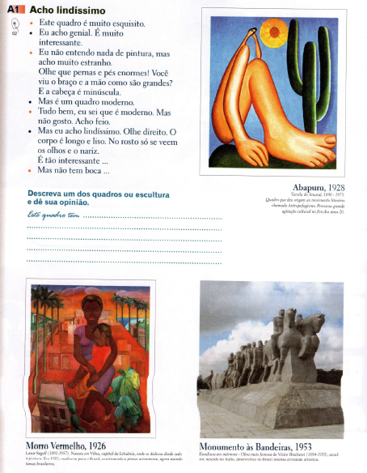
Every Brazilian [insert any stereotype here]
Developing and promoting intercultural communicative competence in language classes
Text Comprehension:
Dialogue
Suggested Vocabulary:
Body parts, opinion, description
Text Production:
Description

Slide 15
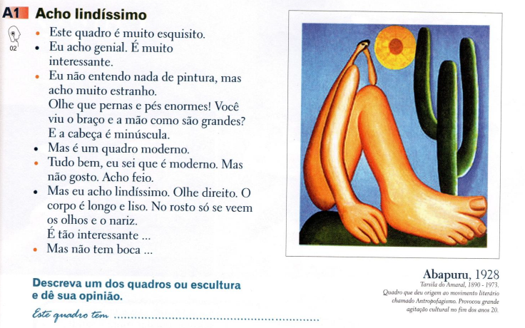
Every Brazilian [insert any stereotype here]
Developing and promoting intercultural communicative competence in language classes

Slide 16
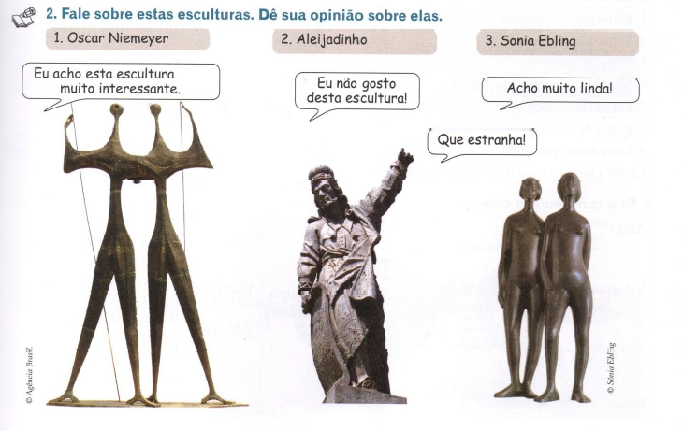
Every Brazilian [insert any stereotype here]
Developing and promoting intercultural communicative competence in language classes

Slide 17
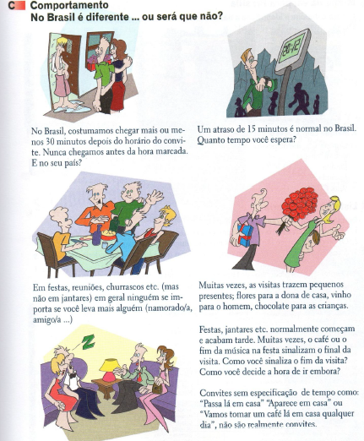
Every Brazilian [insert any stereotype here]
Developing and promoting intercultural communicative competence in language classes
Text Comprehension:
Statements and questions
Suggested Vocabulary:
Events, special occasions
Grammar Resource:
Present
Text Production:
Comparison between Brazilians and you

Slide 18
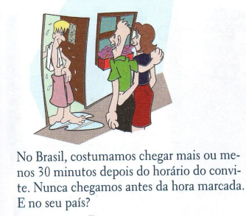
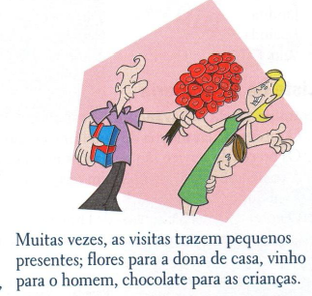
Every Brazilian [insert any stereotype here]
Developing and promoting intercultural communicative competence in language classes

Slide 19
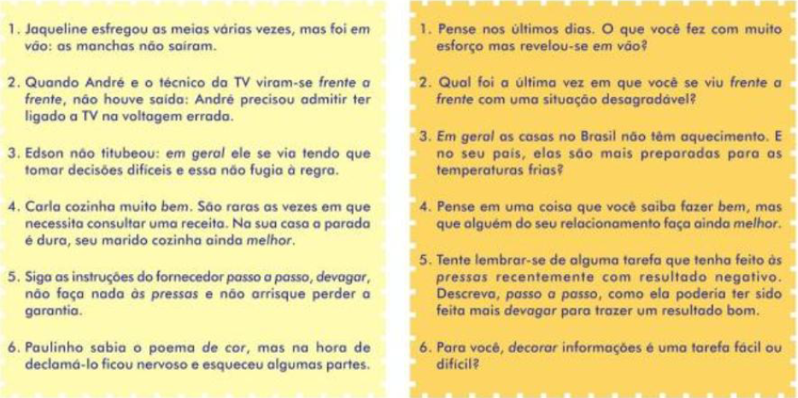
Every Brazilian [insert any stereotype here]
Developing and promoting intercultural communicative competence in language classes

Slide 20
Every Brazilian [insert any stereotype here]
Developing and promoting intercultural communicative competence in language classes
2.2. CRITICAL INTERCULTURAL AWARENESS
Examples of modifications to promote intercultural awareness
(focusing on differences between cultures, not countries)

Slide 21
Every Brazilian [insert any stereotype here]
Developing and promoting intercultural communicative competence in language classes
Text Comprehension:
Short video about the sociocultural background of the painting/painter
Suggested Vocabulary:
Body parts, colors, description, interpretation, evaluation (rationale-based)
Text Production:
Re-interpretation (rationale-based)

Slide 22
Every Brazilian [insert any stereotype here]
Developing and promoting intercultural communicative competence in language classes
Text Comprehension:
Interviews with people from different cultural groups within Brazil
Suggested Vocabulary:
Events, special occasions, traditional dishes, drinks, decorations and/or clothes and why
Grammar Resource:
Present
Text Production:
Show and tell

Slide 23
Every Brazilian [insert any stereotype here]
Developing and promoting intercultural communicative competence in language classes
MAIN POINTS FOR OUR DISCUSSION
1.Definition of Intercultural Communicative Competence (ICC)
2.Cultural Shock vs Critical Intercultural Awareness
3.Description, Interpretation, Evaluation (D.I.E.)

Slide 24
Every Brazilian [insert any stereotype here]
Developing and promoting intercultural communicative competence in language classes
3.THE D.I.E. EXERCISE
3.1.Description: what can be sensed (seen, felt, smelled, heard, tasted), objectively and in detail.
3.2.Interpretation: speculation of the meaning behind what can be sensed.
3.3.Evaluation: opinion attached to a set of values, beliefs and cultural experiences.

Slide 25
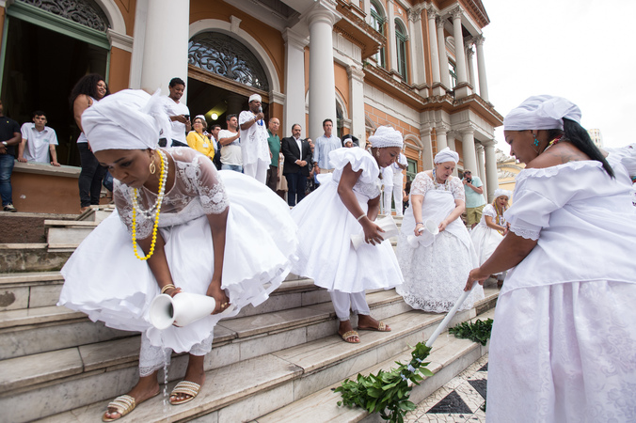
Every Brazilian [insert any stereotype here]
Developing and promoting intercultural communicative competence in language classes
3.1. DESCRIPTION – what do you see?

Slide 26
Every Brazilian [insert any stereotype here]
Developing and promoting intercultural communicative competence in language classes
3.2. INTERPRETATION – what do you think of what you see?

Slide 27
Every Brazilian [insert any stereotype here]
Developing and promoting intercultural communicative competence in language classes
3.3. EVALUATION – how do you feel about what you see/think?

Slide 28
Every Brazilian [insert any stereotype here]
Developing and promoting intercultural communicative competence in language classes
3.3. EVALUATION – how do you feel about what you think?
3.1. DESCRIPTION – what do you see and hear?
3.2. INTERPRETATION – what do you think of what you see/hear?

Slide 29
Every Brazilian [insert any stereotype here]
Developing and promoting intercultural communicative competence in language classes
3.1. DESCRIPTION – what do you hear?
3.2. INTERPRETATION – what do you think of what you hear?
3.3. EVALUATION – how do you feel about what you think?

Slide 30
Every Brazilian [insert any stereotype here]
Developing and promoting intercultural communicative competence in language classes
MAIN POINTS FOR OUR DISCUSSION
1.Definition of Intercultural Communicative Competence (ICC)
2.Cultural Shock vs Critical Intercultural Awareness
3.Description, Interpretation, Evaluation (D.I.E.)

Slide 31
Every Brazilian [insert any stereotype here]
Developing and promoting intercultural communicative competence in language classes
REFERENCES
Bennett, M. J. (2004). Becoming interculturally competent. In J.S. Wurzel (Ed.), Toward multiculturalism: A reader in multicultural education, 2, 62-77.
Byram, M. (2012). Conceptualizing Intercultural (Communicative) Competence and Intercultural Citizenship. In J. Jackson (Ed.), The Routledge Handbook of Language and Intercultural Communication (pp.85-97). London, UK: Routledge.
Carilo, M. S. (2021). Portuguese as an Additional Language within the context of Exchange Program for Undergraduate Students: a proposal for theoretical and pedagogical shift. Revista Linguagem & Ensino 24(1) (in press).
Chapelle, C.A. (2010). If intercultural competence is the goal, what are the materials? Proceedings of Intercultural Competence Conference, August, 2010, 1, 27-50.
Guilherme M, Dietz G (2015) Difference in diversity: multiple perspectives on multi-, inter-, and trans-cultural conceptual complexities. J Multicult Discourse 10(1):1–21.
Kramsch, C. (2010). The Multilingual Subject. Oxford, UK: Oxford University Press.
Liddicoat, A. J. & Scarino, A. (2013). Intercultural Language Teaching and Learning. Malden, MA: Wiley-Blackwell

