Slide 2
Goals for today
saraivacarilo.1@osu.edu

Slide 3
What are we doing?
saraivacarilo.1@osu.edu
PRESENTATION
*Overview of methods, approaches, and pedagogies applied to the Portuguese as a Foreign/Second/Additional Language field from the 60’s to early 2000’s
*Current pedagogies and/or proposals for theoretical/pedagogical updates
*How theoretical assumptions can be translated into practice (especially for material design/adjustment)
HANDS-ON: Content and Tasks
*Grammar-based content
*Vocabulary-driven materials
*Oral tasks – focusing on use of language with pronunciation in the background
*Written assignments and tasks focusing on use of language with accuracy in the background
*Foregrounding cultures without focusing on “yours-vs-theirs” perspectives

Slide 4
Olá!
saraivacarilo.1@osu.edu
Michele Saraiva Carilo
Triple license – ESL, Portuguese, Literatures
Master’s Degree in Applied Linguistics
PhD in Language Education
Postdoctoral Research in Teacher Education
Publications
Proficiency Exam – Celpe-Bras (2008-2010)
Online Education for Spanish Speakers (2010-2013)
Critical and Intercultural Pedagogies (2014-recent)

Slide 5
Overview of methods, approaches, and pedagogies
saraivacarilo.1@osu.edu
PEC-G programs start Grammar-translation phase
Consolidation of Democracy
Proficiency-informed Communicative phase
Crises in Education Proficiency-informed Communicative phase - ONL
Indirect Democracy
Audio-lingual phase
60’s
80’s
00’s
20’s
70’s
90’s
10’s
Militarization of Education
Direct phase
Direct Democracy
Communicative phase
Internationalization
Proficiency-informed Communicative phase

Slide 6
METHODS & APPROACHES: MAIN DEFINITIONS
saraivacarilo.1@osu.edu
Language
System
Instrument
System
Discourse
Language Use
Isolated words
Questions & Answers
Repetition/Drilling
Communicative Tasks
Competence
Grammar/Translation
(Re)production
Pronunciation
Interaction

Slide 7
METHODS & APPROACHES: Portuguese for Spanish Speakers
saraivacarilo.1@osu.edu
Language
System & Discourse
Language Use
Repetition/Drilling
Competence
Comparative/Contrastive Analysis

Slide 8
Problematic notion of authenticity
saraivacarilo.1@osu.edu
Authentic materials
Authentic language
Authentic culture

Slide 9
Current pedagogies and proposals for updates
saraivacarilo.1@osu.edu
Language as a
symbolic system
Competence = becoming multilingual & multicultural citizens
Critical Pedagogy
Language use for social agency
Critical Intercultural Language Education
Intercultural Pedagogy
Culture vs nationality

Slide 10
How theoretical assumptions can be translated into practice?

Slide 11
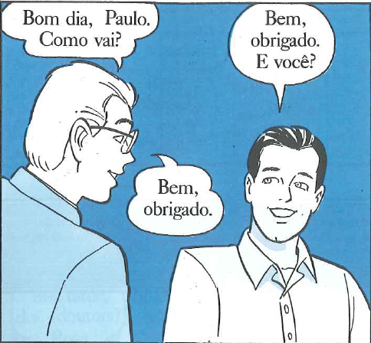
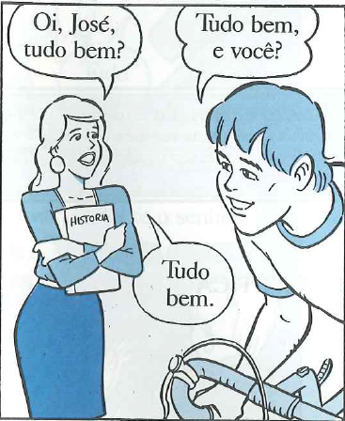
ADAPTATION OF MATERIALS/TEXTBOOKS
saraivacarilo.1@osu.edu
Why would those materials need adaptation?
Fala Brasil (1998)

Slide 12
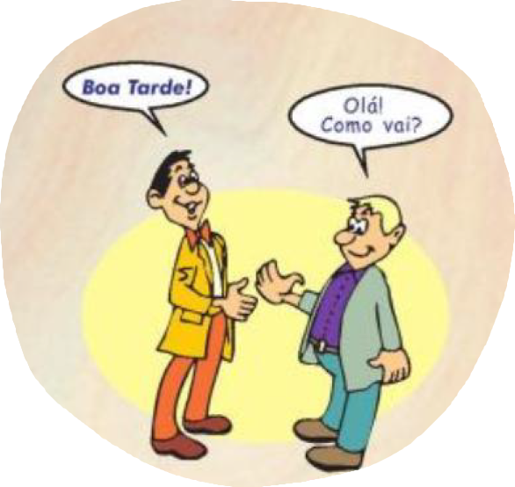
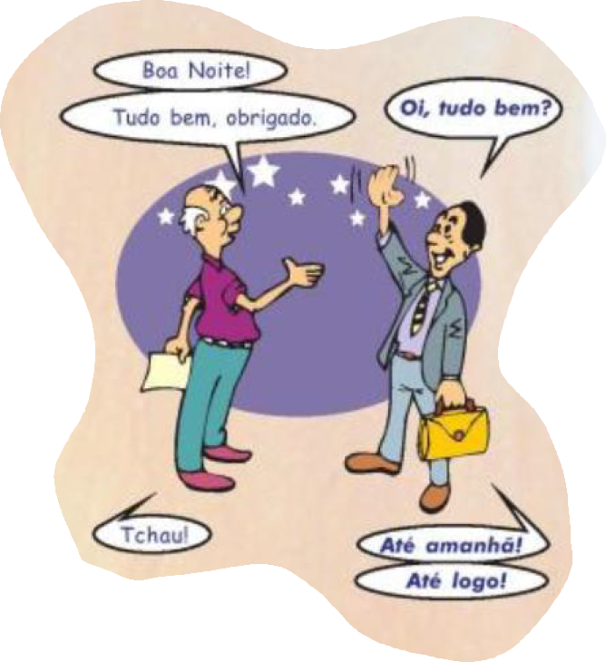
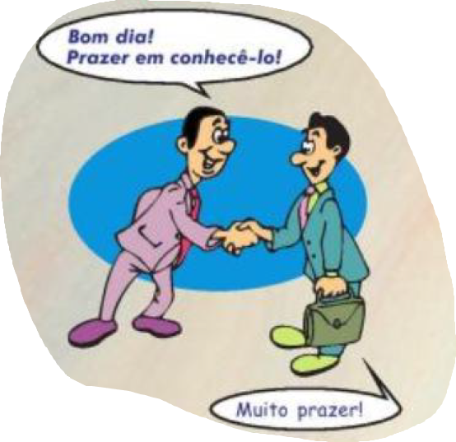
ADAPTATION OF MATERIALS/TEXTBOOKS
saraivacarilo.1@osu.edu
Why would those materials need adaptation?
Bem-vindo (2004)

Slide 13
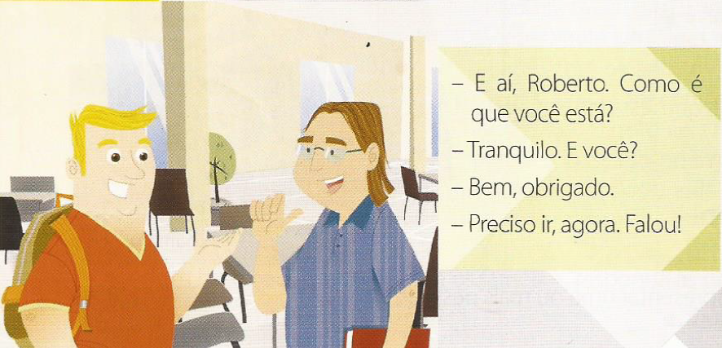
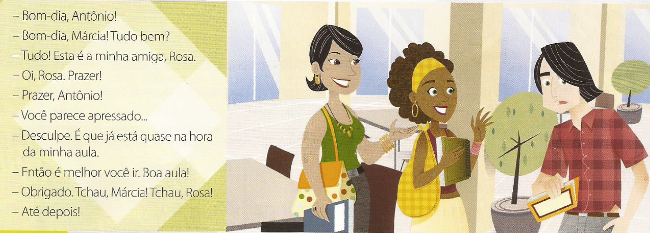
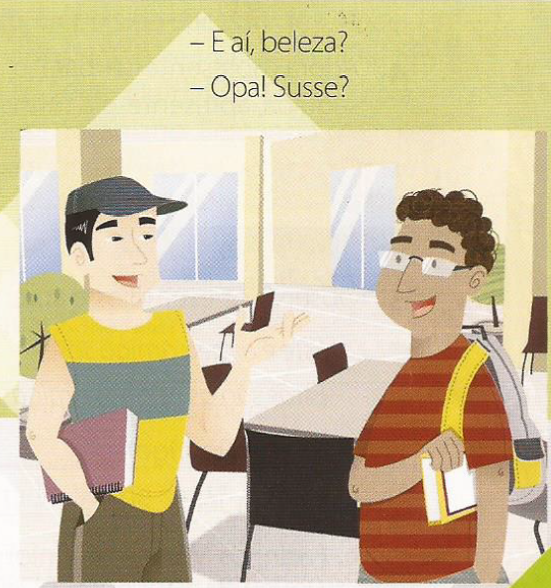
ADAPTATION OF MATERIALS/TEXTBOOKS
saraivacarilo.1@osu.edu
Why would those materials need adaptation?
VIVA!(2010)

Slide 14
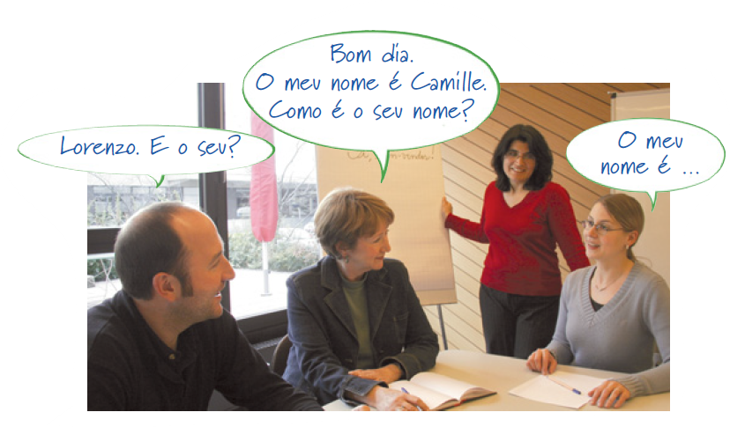
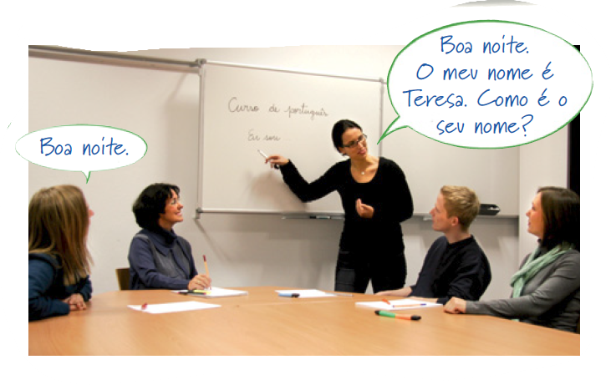
ADAPTATION OF MATERIALS/TEXTBOOKS
saraivacarilo.1@osu.edu
Oi, brasil (2013)

Slide 15
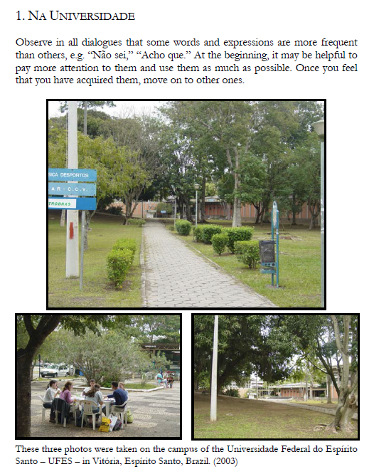
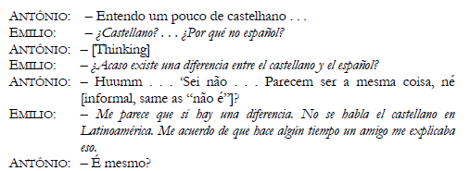
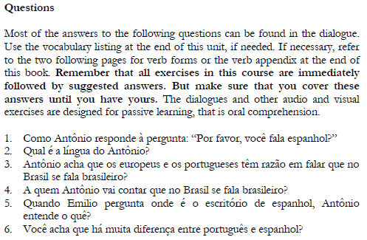
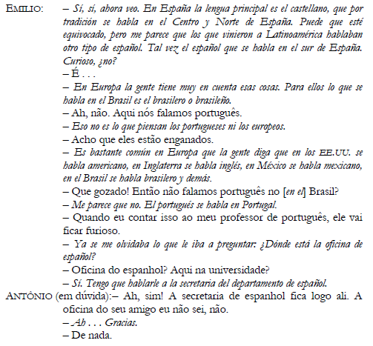
ADAPTATION OF MATERIALS/TEXTBOOKS
saraivacarilo.1@osu.edu
Why would those materials need adaptation?
POIS NÃO(2008)

Slide 16
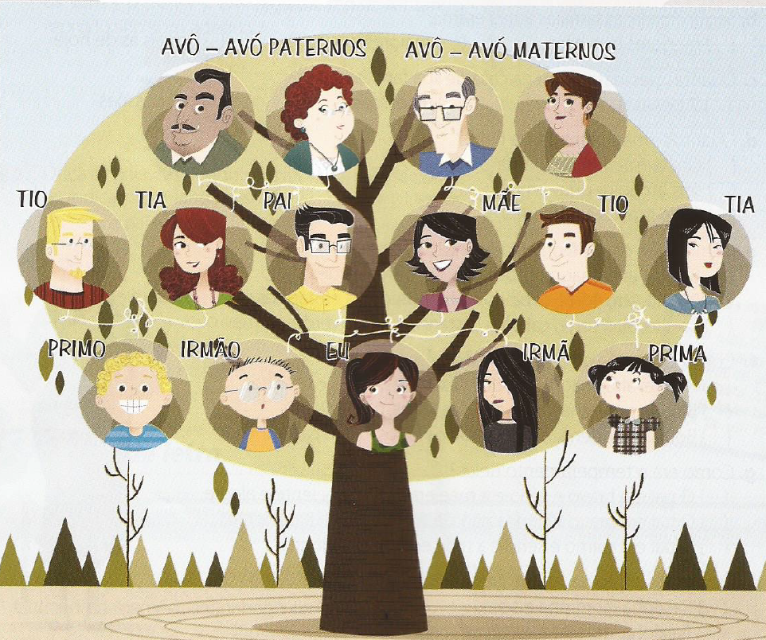
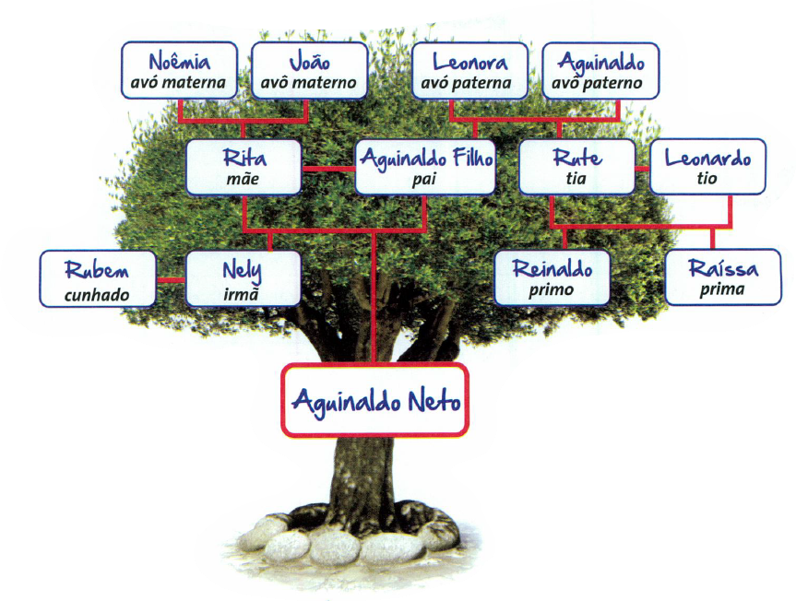
ADAPTATION OF MATERIALS/TEXTBOOKS
saraivacarilo.1@osu.edu
Why would those materials need adaptation?
VIVA!(2010)
Brasil intercultural(2013)

Slide 17
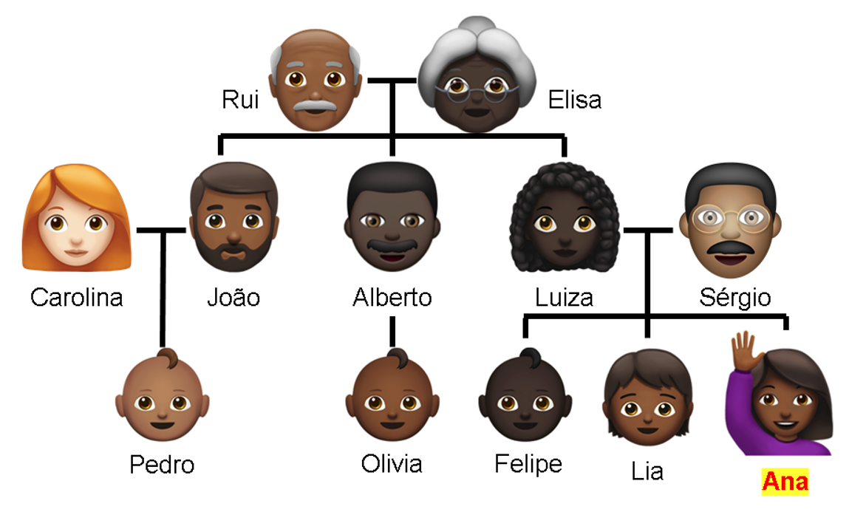
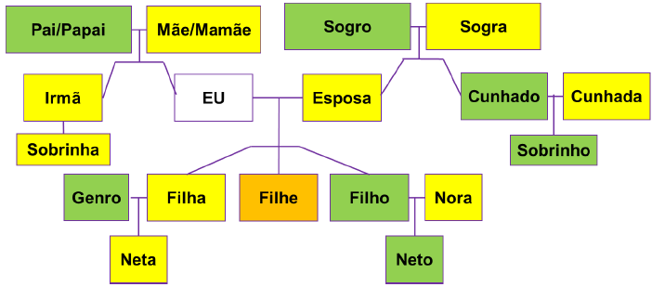
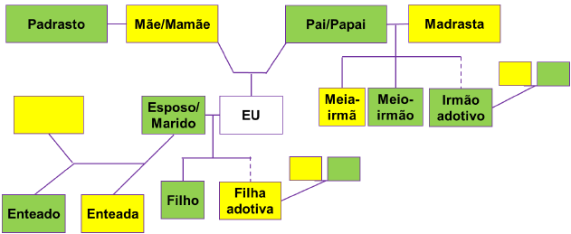
ADAPTATION OF MATERIALS/TEXTBOOKS
saraivacarilo.1@osu.edu
Offering representation by tailoring

Slide 18
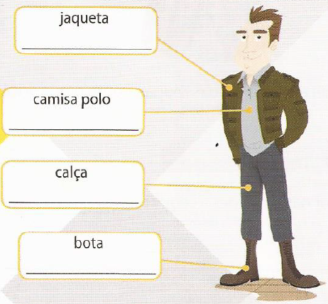
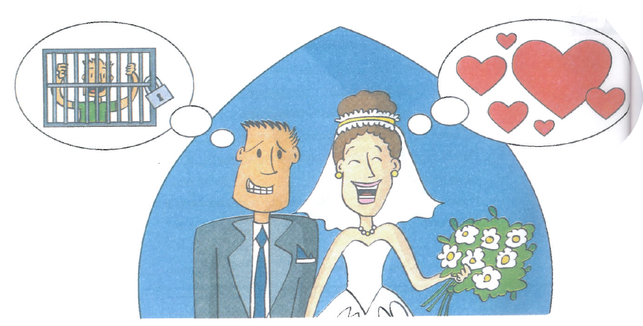
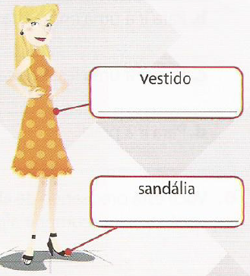
ADAPTATION OF MATERIALS/TEXTBOOKS
saraivacarilo.1@osu.edu
Why would those texts need adaptation?
O portuguÊs bem brasileiro (2012)
Viva!(2010)

Slide 19
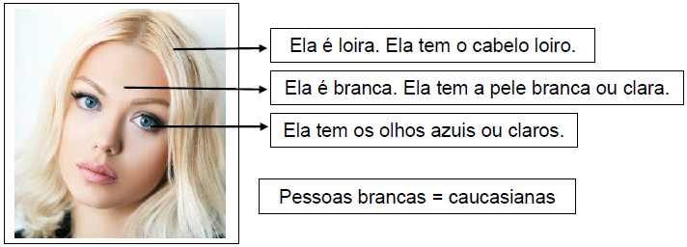
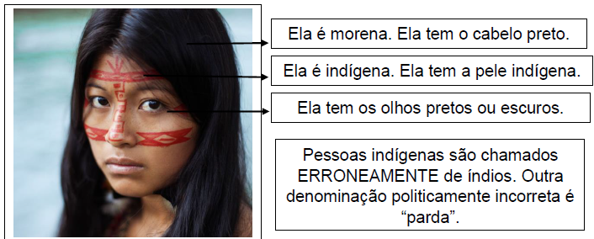
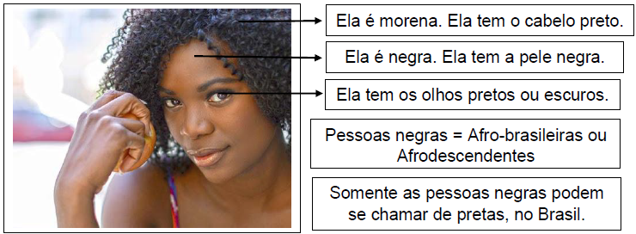
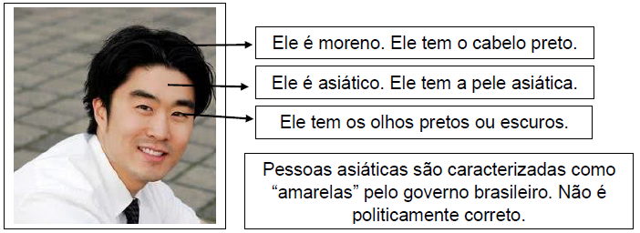
ADAPTATION OF MATERIALS/TEXTBOOKS
saraivacarilo.1@osu.edu
Promoting intercultural representation
within same-language communities

Slide 20
ADAPTATION OF MATERIALS/TEXTBOOKS
saraivacarilo.1@osu.edu
Promoting critical thinking
Brasil intercultural(2013)

Slide 21
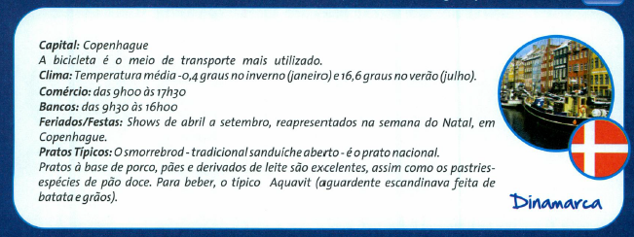
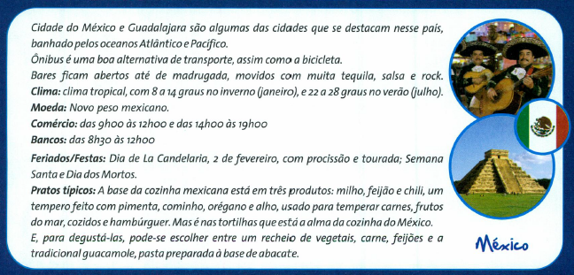
ADAPTATION OF MATERIALS/TEXTBOOKS
saraivacarilo.1@osu.edu
Promoting critical thinking
Brasil intercultural(2013)

Slide 22
Let’s review some concepts
saraivacarilo.1@osu.edu
Language
Symbolic system which is added to an existent repertoire in order to contribute to one’s pluriliteracy.
Language use
Social participation, agency, emancipation in order to question one’s own role in society and the role of others
Culture
Individual and collective references on which one’s world view is based
Competence
Proficiency in accessing one’s own language repertoire and cultural references to describe, interpret, and evaluate the world

Slide 23
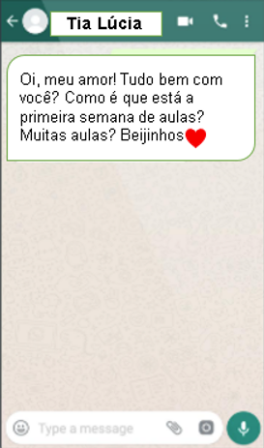
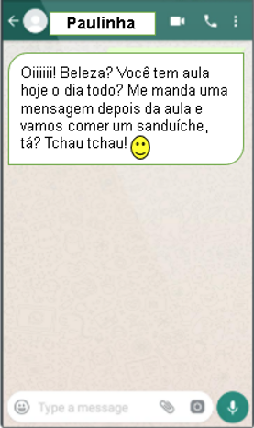
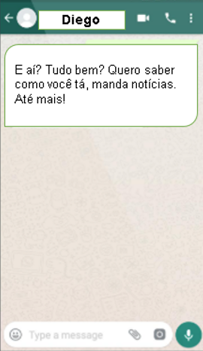
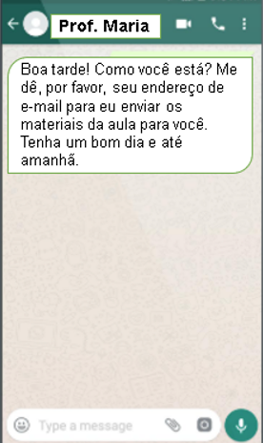
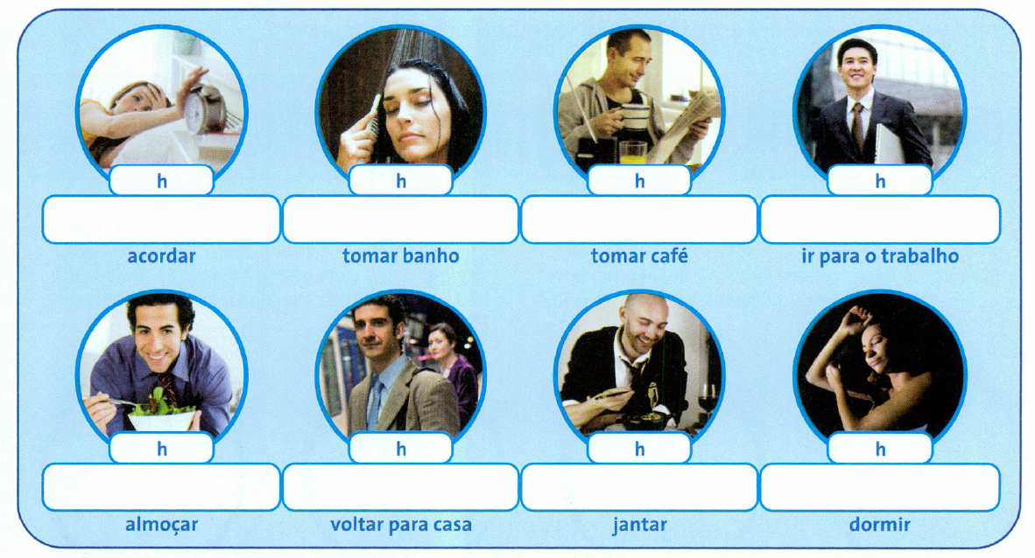
saraivacarilo.1@osu.edu
HANDS-ON: Content and Tasks
*Grammar-based content

Slide 24
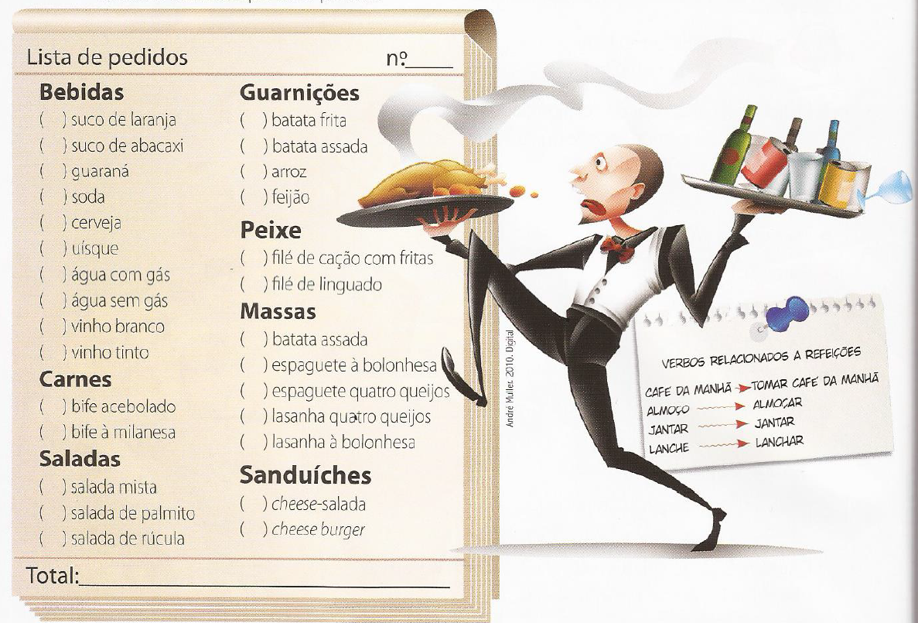
saraivacarilo.1@osu.edu
HANDS-ON: Content and Tasks
*Vocabulary-driven materials
Oral text for presentation
Written text for clarification
Task for production

Slide 25
saraivacarilo.1@osu.edu
HANDS-ON: Content and Tasks
*Oral tasks – focusing on use of language with pronunciation in the background
Interaction – Freer Practice
Questions related to theme & content
Focus on pronunciation when problematic

Slide 26
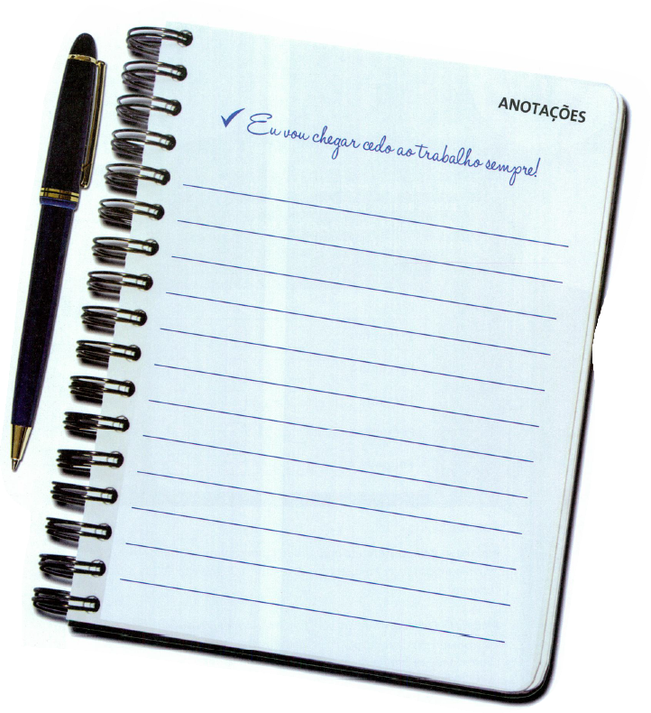
saraivacarilo.1@osu.edu
HANDS-ON: Content and Tasks
*Written assignments and tasks focusing on use of language with accuracy in the background
Provide a model and/or provoking element (oral/written/non-verbal text)
Questions for reflection/brainstorming
Production with a purpose

Slide 27
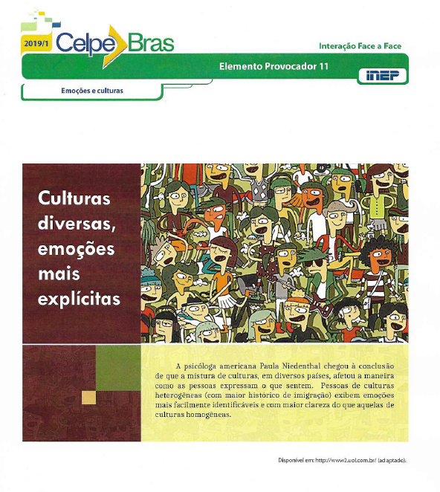
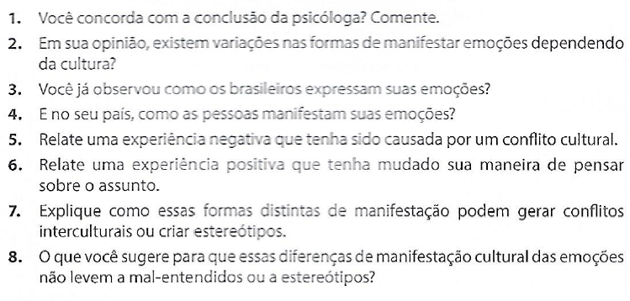
saraivacarilo.1@osu.edu
HANDS-ON: Content and Tasks
*Foregrounding cultures without focusing on “yours-vs-theirs” perspectives

Slide 28
saraivacarilo.1@osu.edu
HANDS-ON: Content and Tasks
*Foregrounding cultures without focusing on “yours-vs-theirs” perspectives
Provide a model and/or provoking element (oral/written/non-verbal text)
D.I.E. strategy for activation of cultural reference and language repertoire
Critical oral production for debate based on reflection, experiences, and/or others’ reports

Slide 29
saraivacarilo.1@osu.edu
HANDS-ON: Content and Tasks
*Foregrounding cultures without focusing on “yours-vs-theirs” perspectives
Describe
Interpret
Evaluate

Slide 30
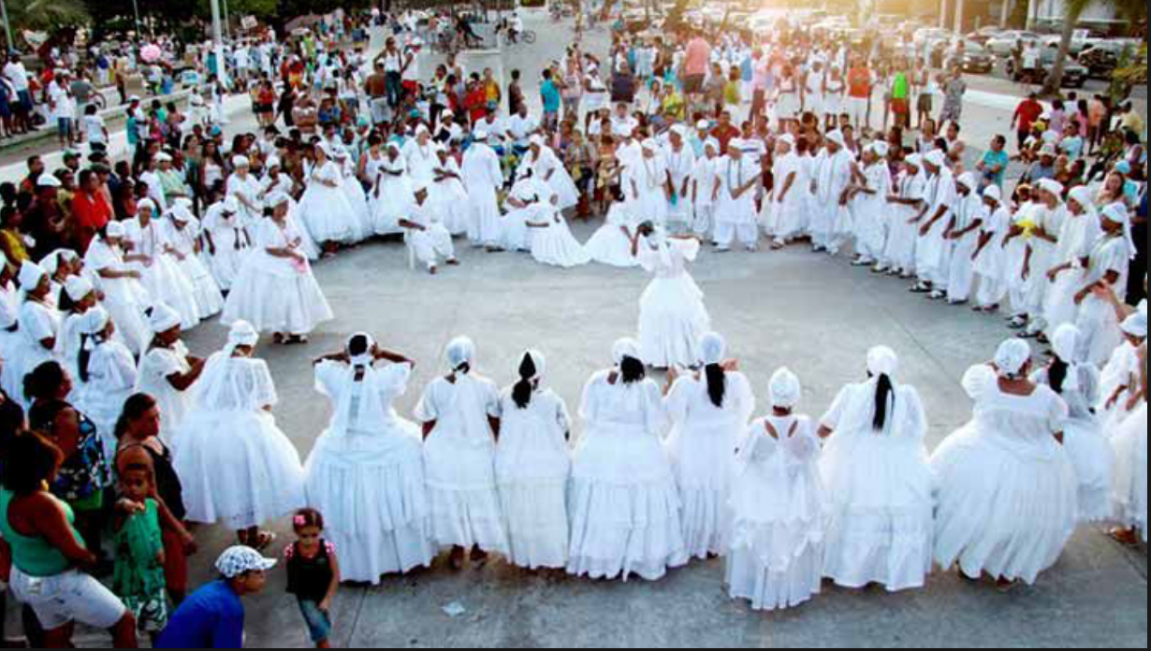
saraivacarilo.1@osu.edu
HANDS-ON: Content and Tasks
*Foregrounding cultures without focusing on “yours-vs-theirs” perspectives
Describe
Interpret
Evaluate

Slide 31
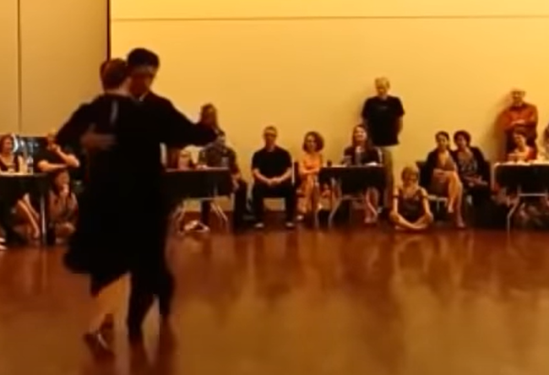
saraivacarilo.1@osu.edu
HANDS-ON: Content and Tasks
*Foregrounding cultures without focusing on “yours-vs-theirs” perspectives
Describe
Interpret
Evaluate

Slide 32
YOUR TURN!!!
saraivacarilo.1@osu.edu
Choose Select a theme, topic, content, etc. that you find challenging to work in your classroom
Share Talk to your peers in the breakout room about it
Brainstorm Come up with some ideas for adjustment and/or design
Present Tell us what you’ve got!

Slide 33
QUESTIONS?
saraivacarilo.1@osu.edu
COMMENTS?
saraivacarilo.1@osu.edu

Slide 34
Thanks! ¡GRACIAS! OBRIGADA!
saraivacarilo.1@osu.edu

